Slide 1
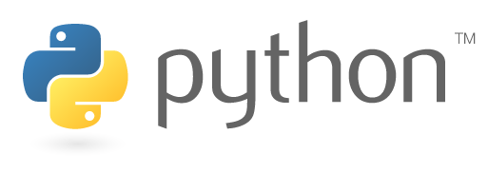
UNIT-1
Introduction to Python Programming

Slide 2
Syllabus
UNIT I
Introduction to Python: Features of Python, Execution of a Python Program, Viewing the byte code, Flavors of Python, Python Virtual Machine, Comparisons between C and Python, installing python for windows, numpy, pandas and Matplotlib, Executing a python using command Line Window and Python’s IDLE.
Data types in Python: Comments in Python, Docstrings, Built-in datatypes: None, Numeric and bool Data type, Sequences in python: str, bytes, byte array data types, list, tuple,dictionaries, user-defined datatypes, constants in python, identifiers and reserved words, naming conventions in python.
UNIT II
Variables and Operators:Understanding Python variables, multiple variable declarations, Operators in Python: Arithmetic operators,
Assignment operators, Relational Operators, Logical operators, Boolean Operators, Bitwise operators, Membership operators, Identity
operators, Operator Precedence and Associativity, Output statements, Input Statements and Command Line Arguments.
CONTROL STATEMENTS: Indentation, The if Statement, if…else, if … elif … else statement, while loop, for loop, Infinite loop, Nested
Loops, The else suite, break, continue, pass statement, assert and return statement

Slide 3
Syllabus
UNIT III
ARRAYS : Advantages of Arrays, Creating an Array, Importing the Array Module, Indexing and Slicing on Arrays, Types of arrays, working with arrays using numpy.
FUNCTIONS: Defining a Function, calling a function, Formal and Actual Arguments, Positional Arguments, keyword Arguments, Default Arguments, variable length arguments, local and global variables, Anonymous Functions or Lambdas
UNIT IV
DATA STRUCTURES IN PYTHON: Working with Linked Lists, Stacks and Queues, Searching Algorithms: linear search and binary search, Sorting Algorithms: Bubble Sort, Insertion Sort, Selection Sort and Merge Sort
UNIT V
GRAPHS &TREES :
Graphs – Breadth First Search, Depth First Search. Trees - Binary search trees: find, insert, delete, Tree Traversal Techniques: Inorder, preorder, postorder.

Slide 4
Syllabus
TEXT BOOKS
R. Nageswara Rao, “Core Python Programming”, dream tech
Data structures and algorithms in python by michael t. goodrich
Allen B. Downey, ``Think Python: How to Think like a Computer Scientist‘‘, 2nd edition, Updated for Python 3, Shroff/O‘Reilly Publishers, 2016.
Python Programming: A Modern Approach, Vamsi Kurama, Pearson
Data Structures and Algorithmic Thinking with Python by Narasimha Karumanchi
REFERENCE BOOKS:
Core Python Programming, W.Chun, Pearson.
Introduction to Python, Kenneth A. Lambert, Cengage
Learning Python, Mark Lutz, Orielly

Slide 5
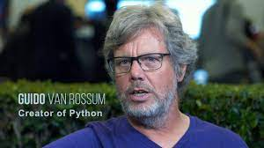
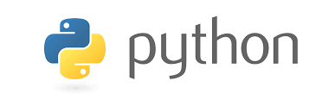
History
Python was developed by Guido Van Rossum in the year 1991 at the centre of
Mathematics and Computer Science managed by the Dutch Government.
Van Rossum picked the name python for the new language from the TV show, “Monty python’s Flying Circus”.
It is one of the funny circus game show, The python developer Rossum is very impressed about this show, that’s way the word Python’s is taken from this show.
The first working version was ready by early 1990 and Van Rossum released it for the public on February 20, 1991.
The Logo of the python shows two intertwined snakes

Slide 6
Introduction
The Python programming language is an object-oriented language, which means that it can model real-world entities. It is also dynamically-typed because it carries out type-checking at runtime.
The distinctive feature about Python is that it is an interpreted language.
What makes Python so powerful?
Apart from the constructs that Python provides, you can use the PyPI (Python Package Index). It is a repository of third-party Python modules and you can install it using a program called pip. Run the following command in Command Prompt:
pip install library_name

Slide 7
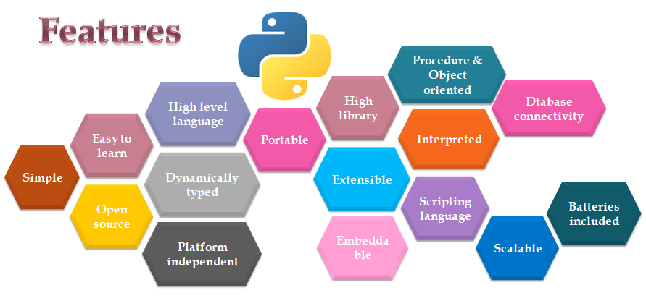
Features of Python:
There are various reasons why python is gaining good popularity in the programming community. The following are some of the important features of python:

Slide 8
Features of Python:
Simple
Easy to Learn
Open Source
High Level Language
Dynamically Typed
Plat form Independent
Huge Library
Scripting Language
Database Connectivity
Scalable
Batteries included
Portable
Interpreted
Extensible
Embeddable
Easy to Understandable

Slide 9
Features of Python:
Dynamically Typed: In Python, we need not to declare anything. An assignment statement binds a name to an object, and the object can be of any type. If a name is assign to an object of one type, it may later be assigned to an object of a different type. This is a meaning of the saying that python is a dynamically typed language.
Plat form Independent: When a python program is compiled using a python compiler, it generates byte code. Python’s byte code represents a fixed set of instructions that runs on all operating systems and hardware. Using a python virtual machine, anybody can run these byte code instructions on any computer system. Hence, python program are not dependent on any specific operating system.
It executes the code line by line in a REPL (Read-Evaluate-Print-Loop) fashion

Slide 10
Features of Python:
Scripting Language: A Scripting Language is a programming language that does not use a compiler for executing the source code. Rather, it uses an interpreter to translate the source code into machine code on while running. Generally, scripting languages perform supporting tasks for a bigger applications or software.
Huge Library: Python has a big library which can be used on any operating system like UNIX,Windows or Macintosh. Programmers can develop programs very easily using the modules available in the Python library.

Slide 11
Features of Python:
Batteries included: The Huge library of python contains several small applications which are already developed and immediately available to programmers. These small packages can be used and maintained easily. Thus the programmers need not to download separate packages or applications in many cases. These libraries are called ‘batteries included’.
Interpreted: A Program code is called source code. After writing a python program we should compile the source code using python complier. Python complier translates the python program into an intermediate code called byte code. This byte code is then executed by PVM. Inside the PVM, an interpreter converts the byte code instructions into machine code so that the processor will understand and run that machine code to produce results.

Slide 12
Features of Python:
Extensible: The Programs or pieces of code written in C or C++ can be integrated into python and executed using PVM. This is what we see in standard python that is downloaded from www.python.org. There are others flavors of python where programs from other languages can be integrated into python. For example, Jython is useful to integrate java code into python programs and run on JVM (java virtual machine).
Embeddable: We can insert python programs into C or C++ program. Several applications are already developed in python which can be integrated into other programming languages like C, C++, PHP, Java and .NET. It means programmers can use these applications for their advantage in various software projects.

Slide 13
How Does Python Interpreter Works?
Well, internally, four things happen in a REPL: i. Lexing- The lexer breaks the line of code into tokens. ii. Parsing- The parser uses these tokens to generate a structure, here, an Abstract
Syntax Tree, to depict the relationship between these tokens. iii. Compiling- The compiler turns this AST into code object(s). iv. Interpreting- The interpreter executes each code object.

Slide 14
Execution of a python program
write a python program with the name x.py
here, x is the program name, and
.py is the extension name.
the next step is to compile the program using python compiler . The compiler converts the Python program into another code called byte code .
Byte code represents o fixed set or instructions that represents all operation s like arithmetic operations , comparison operations, memory related operation s, e t c ., which run on any operating system and hardware .
It means that byte instructions are system independent or platform independent.
The size of each code instruction is 1 byte and hence they are called with the name byte code.
These byte code instructions are contained in the file x.pyc . Here the x.pyc file represents a python compiled file.

Slide 15
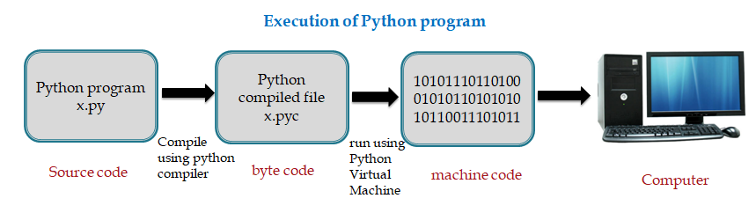
Execution of a python program
The next step is to run the program.
Since the binary code is understandable to the machine(computer),it is also called machine code.
It is therefore necessary to convert the byte code into machine code so that our computer can understand and execute it. For this purpose, we should use PVM(Python Virtual Machine).

Slide 16
Execution of a python program
Normally , when we compile a python program, we cannot see the .pyc file produced by the python compiler and the machine code generated by the PVM. This is done internally in the memory and the output is finally visible .
For example , if our python program name is x.py , we can use python compiler to compile it
C:\python x.py
To create .pyc file from the source code,we can use the following command.
C:\>python -m py _compile x.py
-m represents module and the module name is py_compile
Sometimes the .pyc file name may be something like ; x.cpython-34.pyc
C:\>python x.cpython-34.pyc

Slide 17
Execution of a python program
C:\>python x.cpython-34.pyc
In this case , we are supplying .pyc file to the python compiler.
Now ,python compiler will skip the first step where it has to convert the source code into byte code as already it sees the byte code inside the .pyc file .
This is executed directly by the PVM to produce the output.
Hence , the program takes less time to run and the performance will be improved.
This is the reason that after the completion of the project , the .pyc files are distributed to the user who can directly run these files using PVM and view the output.

Slide 18
Viewing the byte code
Lets consider the following python program:
#python program to add two numbers
a = b = 10 #take two variables and store 10 in to them
print(“Sum= “ ,(a+b)) # display their sum
we can type this program in text editor like notepad and then save it as ‘first.py’. it means, the first.py file contains the source code.
Now, lets compile the program using python compiler as:
C:\>python first.py
It will display the results as:
Sum = 20

Slide 19
Viewing the byte code
That is ok. But we do not want the output of the program .
we want to see the byte code instructions that were created internally by the python compiler before they are executed by the PVM.
For this purpose, we should specify the dis module while using python command as:
C:\>python -m dis first.py
The preceding byte code is displayed by the dis module, which is also known as ‘ disassembler’ that displays the byte code in the human understandable format.

Slide 20
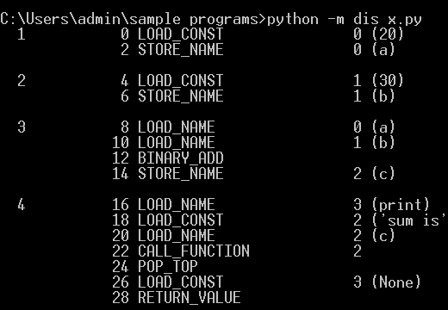
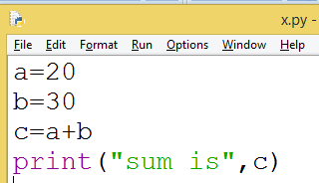
Viewing the byte code
If we observe the preceding code we can find 5 columns.
The left-most or first column represents the line number in our source program (first.py).
The second column represents the offset position of the byte code.
The third column shows the name of the byte code instructions.
The fourth column represents instructions argument and
The last column represents constants or name as specified by 4thcolumn .

Slide 21
Viewing the byte code
The LOAD_NAME specifies that this byte code instructions has 2 arguments .
the name that has 2 arguments is (print)function . since there are 2 arguments .
the next byte code instructions will represents those 2 arguments as LOAD_CONST represents the string constant name (‘Sum = ‘) and (a) and (b) as names involved in the second arguments for the print function.
Then BINARY_ADD instruction adds the previous (i.e., a and b)values

Slide 22
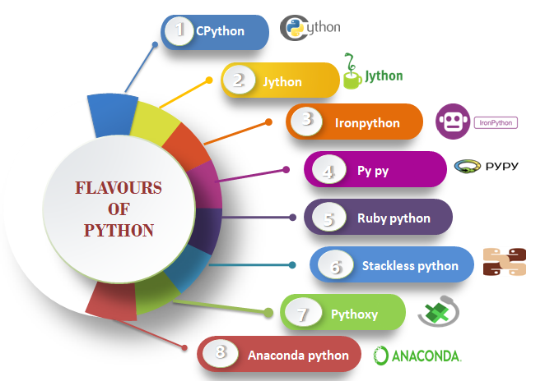
Flavour of python
Flavour of python refer to the different types of python compiler
the flavours are useful to integrate various programming language into python

Slide 23
PYTHON VIRTUAL MACHINE (PVM)
A python compiler does the same task but in a slightly different manner. It converts the program source code into another code, called byte code.
The role of Python Virtual Machine (PVM) is to convert the byte code instructions into machine code so that the computer can execute those machine code instructions and display the final output.
To carry out this conversion, PVM is equipped with an interpret. The interpret converts the byte code into machine code to the computer processor for execution.
Since interpreter is playing the main role, often the Python Virtual Machine is also called an interpreter.

Slide 24
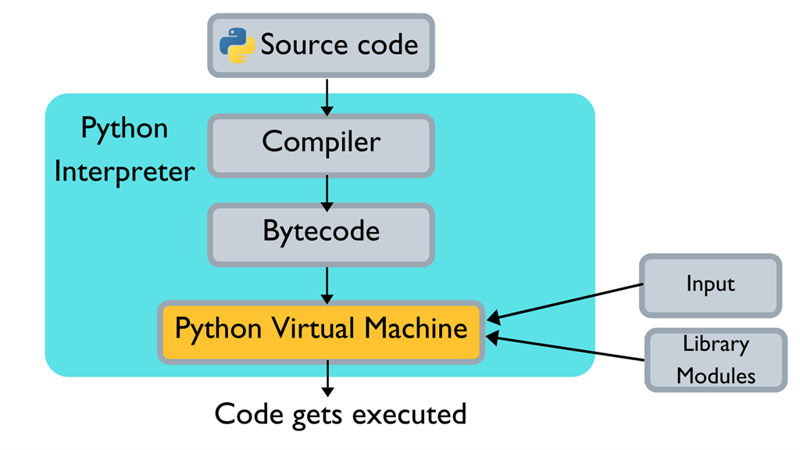
PYTHON VIRTUAL MACHINE (PVM)

Slide 25
PYTHON VIRTUAL MACHINE (PVM)
Steps involved when you run your Python code,
The compiler receives the source code.
The compiler checks the syntax of each line in the source code.
If the compiler encounters an error, it halts the translation process with an error message
(Syntax error).
Else if the instruction is well formatted, then it translates the source code to Bytecode.
Bytecode is sent to the Python Virtual Machine (PVM)
Bytecode along with the inputs and Library modules is given as the input to the PVM.
PVM executes the Bytecode and if any error occurs, it displays an error message
(Runtime error).
Otherwise, if there is no error in execution, it results in the output.

Slide 26
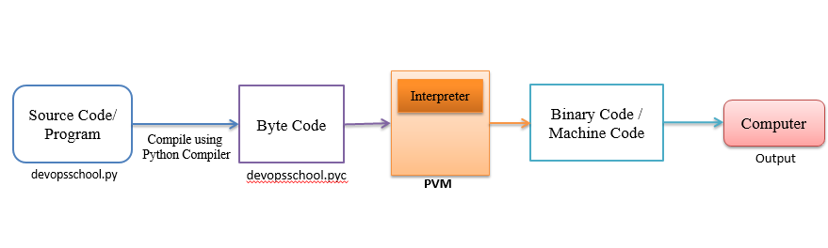
PYTHON VIRTUAL MACHINE (PVM)

Slide 27
Python Applications
some of the cool things that you can do with Python are –
Build a website
Develop a game
Perform Computer Vision (Facilities like face-detection and color-detection)
Implement Machine Learning (Give a computer the ability to learn)
Enable Robotics
Perform Web Scraping (Harvest data from websites)
Perform Data Analysis
Automate a web browser
Perform Scripting
Perform Scientific Computing
Build Artificial Intelligence

Slide 28
Comparisons between C and Python:
S.NO | Key | C Language | Python Language
1 | Definition | C is a general-purpose programming language that is extremely popular, simple and flexible. It is machine-independent, structured programming language which is used extensively in various applications. | Python is a general-purpose interpreted, interactive, object-oriented, and high-level programming language.
2 | Type | structured type programming language and following Imperative programming model. Also it is statically typed. | object-oriented type programming language and dynamically typed.
3 | Variable Declaration | Variables are need to be declared in C before get used in code further. | While on other hand in Python no need of variable declaration for its use.

Slide 29
Comparisons between C and Python:
S.NO | Key | C Language | Python Language
4 | Compilation | C language is compiled by the compiler hence is also known as compiled language. | On other hand interpreter is used in Python for interpreting the code and hence Python is known as Interpreted language.
5 | Functions available | C language has limited number of built-in functions as compared to that in Python language. | On other hand Python has a large library of built-in function as compared to C language.
6 | Execution | As mentioned in above point C is a compiled language hence its code is compiled direct to machine code which is executed directly by the CPU. | On other hand in case of Python code is firstly compiled to a byte-code and then it is interpreted by a large C program.

Slide 30
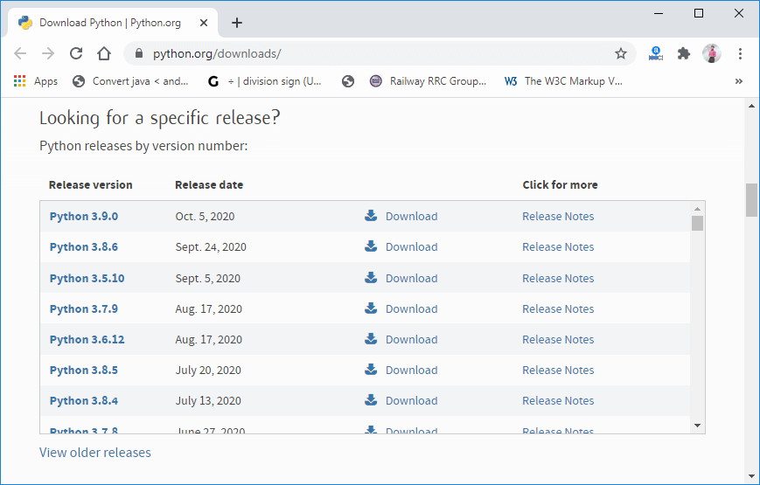
Installing Python for Windows
Visit the link https://www.python.org/downloads/ to download the latest release of Python.
In this process, we will install Python 3.8.6 on our Windows operating system.
When we click on the above link, it will bring us the following page.
Step - 1: Select the Python's version to download.

Slide 31
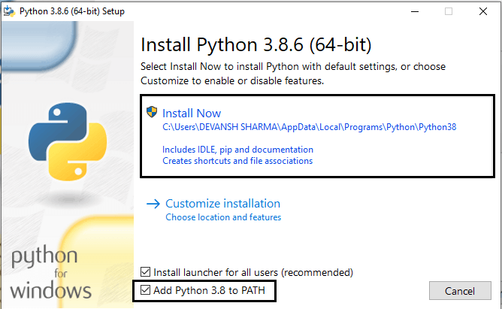
Installing Python for Windows
Step - 2: Click on the Install Now
Double-click the executable file, which is downloaded; the following window will open. Select Customize installation and proceed. Click on the Add Path check box, it will set the Python path automatically.
We can also click on the customize installation to choose desired location and features. Other important thing is install launcher for the all user must be checked.

Slide 32
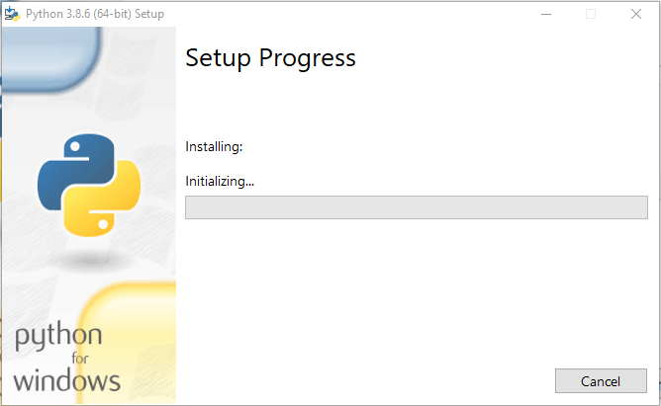
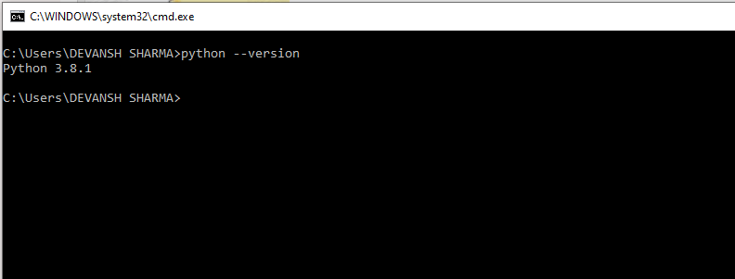
Installing Python for Windows
Step - 3 Installation in Process
We are ready to work with the Python.
Now, try to run python on the command prompt. Type the command python -version in case of python3.

Slide 33
Executing a Python Program
The first two are called interactive modes where we can type the program one line at a time and the PVM executes it immediately .
The last one is called non- interactive mode where we ask the PVM to execute our program after typing the entire program.
There are three ways of executing a python Program.
Using Python’s command Line window
Using Python’s IDLE graphics window
Directly from System prompt

Slide 34
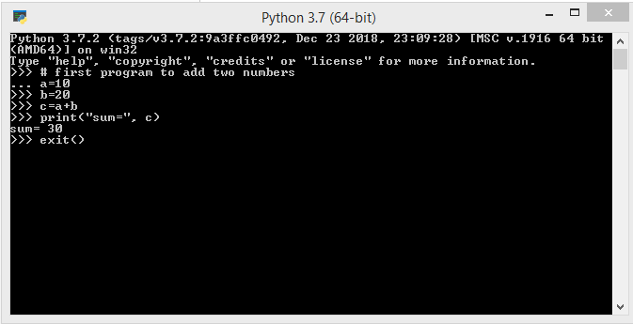
Executing a Python Program
Using Python’s Command Line Window
This will open python’s command line window.
We can see >>> symbol which is called python prompt.
Type our first python program at the >>>prompt, as shown in below figure
After typing the last line and pressing the Enter button, we can see the result of our program. After that, type exit() or quit() at the python prompt. This will terminate the PVM and close the window.

Slide 35
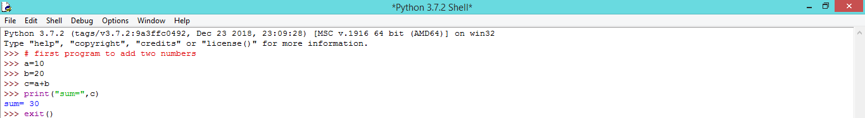
Executing a Python Program
Using Python’s IDLE Graphics Window
It is possible to execute a python program by going to Integrated Development Environment (IDE)which provides graphical interface to the user. Click the Python’s IDLE icon. That will open the python’s IDLE window.
Type the program and entering the last line, we can see the result, as show in below figure

Slide 36
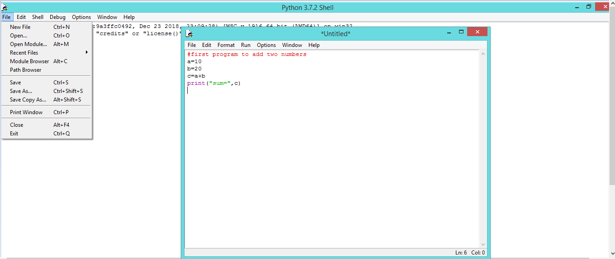
Executing a Python Program
When the programmer wants to type a big program, then the best way is to use the file ->New file option in the IDLE window.
Then it opens a new window where we can type the entire program, as shown in below figure

Slide 37
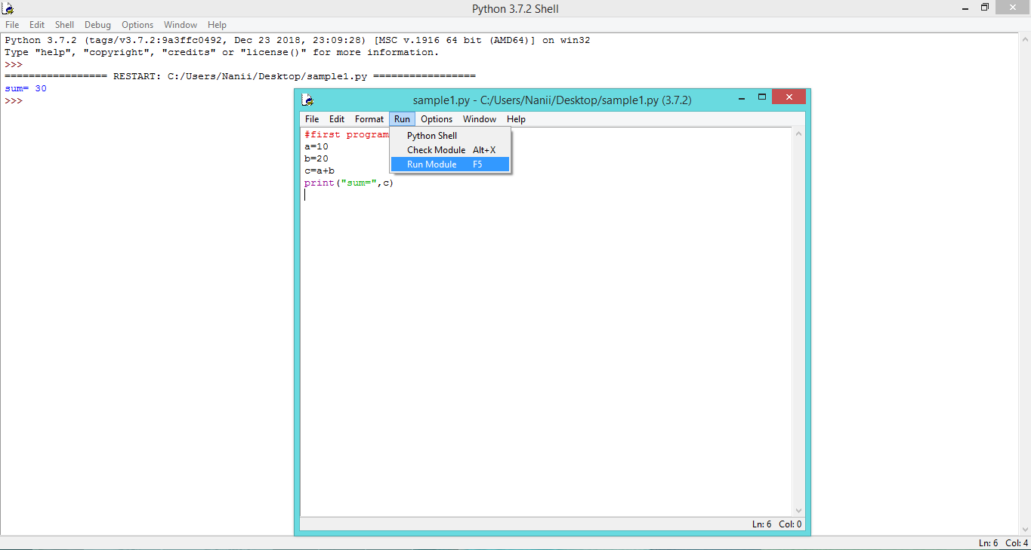
Executing a Python Program
After typing the program, save it by clicking File->Save in the program window and then type a file name and .py as extension name in a directory. This is shown in below figure
We can compile and run the program by using the options File Run -> Run module or by simply pressing F5 the button on the keyboard. A new window will open where the results are displayed, as shown in figure

Slide 38
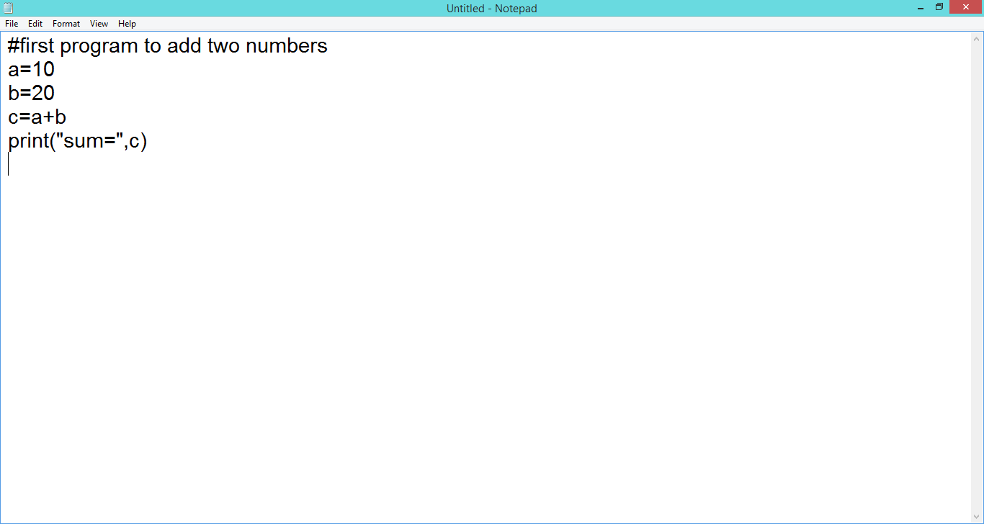
Executing a Python Program
Running Directly from System Prompt
In Most programming environments like Java or .Net, we can generally type the program in a text editor like Notepad or EditPlus.
After typing the entire program, as we save it and then call the compiler to compile the program.
Let’s perform the following steps to run the program directly from the system prompt:
Open a text editor and type the programs, as shown in below figure

Slide 39
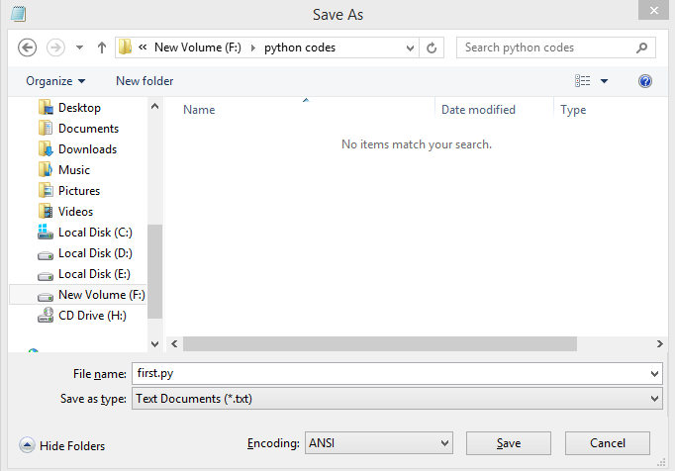
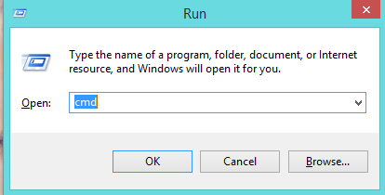
Executing a Python Program
Save the program by clicking File -> Save as. Type the program name as “first.py”,as shown in below figure
All the python programs should be have .py as the file name extension.
3. Open the command prompt (or DOS prompt) window and go to that directory where the program is saved.
This can be done by typing COMMAND or CMD commands at start-> Run.

Slide 40

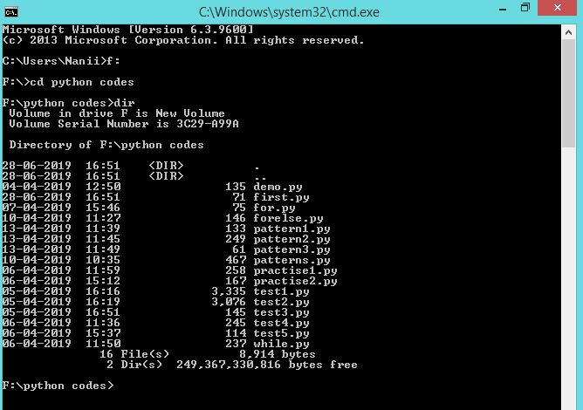
Executing a Python Program
Go to that directory where our python program is saved.
Suppose, we have saved our program in ‘F:’ drive and in the ‘python codes’ directory.
Now, change the directory to F:\python codes using the CD (change Directory to) command as:

Slide 41
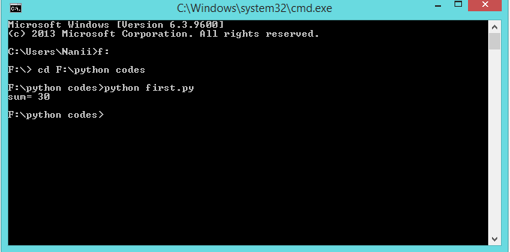
Executing a Python Program
Lets now execute the first.py program by calling the python command.
For this purpose type python along with the file name at the command prompt windows as:
To close the command prompt window we can type exit as:

Slide 42
Install NumPy
NumPy (Numerical Python) is an open-source library for the Python programming language.
It is used for scientific computing and working with arrays.
Apart from its multidimensional array object, it also provides high-level functioning tools for working with arrays
Pip a package manager for installing and managing Python software packages.
Verify NumPy Installation
Use the show command to verify whether NumPy is now part of you Python packages:
pip show numpy
The output should confirm you have NumPy, which version you are using, as well as where the package is stored.
Install NumPy
With Pip set up, you can use its command line for installing NumPy.
pip install numpy
Upgrading NumPy
If you already have NumPy and want to upgrade to the latest version
pip install --upgrade numpy

Slide 43
Install Pandas
Pandas provide essential data structures like series, dataframes, and panels which help in manipulating data sets and time series.
Install
Pip install pandas
to get started with Data Science, to analyze huge sets of data, And to manipulate spreadsheets and
CSVs with just a few lines of code, we use Pandas libraries

Slide 44
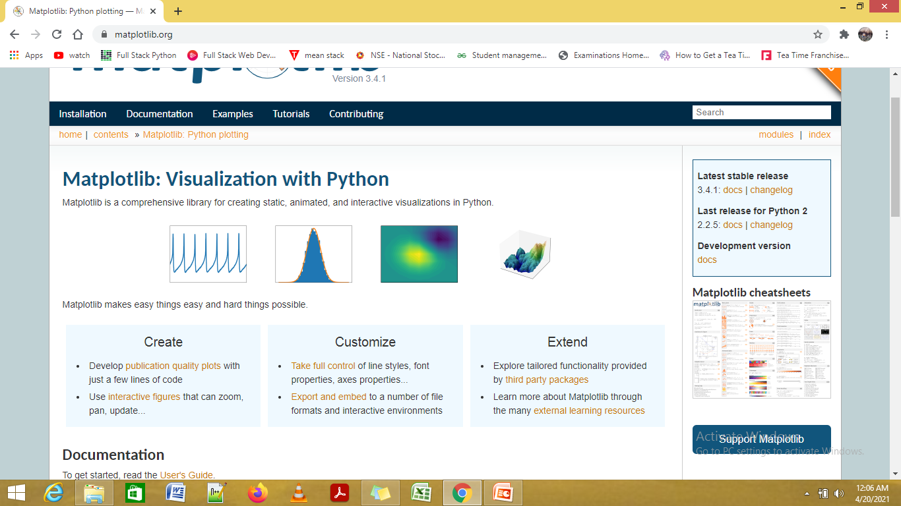
Install matplotlib
Matplotlib is a popular Python package used to build plots.
Matplotlib is a comprehensive library for creating static, animated, and interactive visualizations in Python
plots included in scientific publications and presentations are generated.
pip install matplotlib
Verify the installation
>>> import matplotlib
>>> matplotlib.__version__
'3.1.1'

Slide 45

www.mallareddyuniversity.ac.in
Notes:
You can safely remove this slide. This slide design was provided by SlideModel.com – You can download more templates, shapes and elements for PowerPoint from http://slidemodel.com

